Slide 1
DNA Technology
This section looks at the techniques and applications of DNA technology, and briefly looks at ethics

Slide 2
Genetic recombination
AKA genetic engineering. It’s a process in which genes are transferred between chromosomes, including those of different species. It differs from selective breeding because it breaks the species barrier – genes can be inserted from completely unrelated organisms. An organism produced in this way is called a GMO (genetically modified organism) and could never arise in nature.

Slide 3
Examples of GMOs
Golden rice: engineered to produce high levels of β-carotene, the building block of Vitamin A
Pest-resistant cotton: engineered to contain its own pesticide, reducing the need for broadscale spraying
Bacteria that can help clean up oil spills have been produced. They are sprayed on the spilt oil and digest it. They can then be harvested as a protein source
Tomatoes have been engineered to last longer by switching off the gene for ripening. This extends the shelf life of the tomato
Recombinant yeasts produce human insulin for use by diabetics. Prior to this, insulin was harvested from pigs, causing allergic reactions in some people

Slide 4
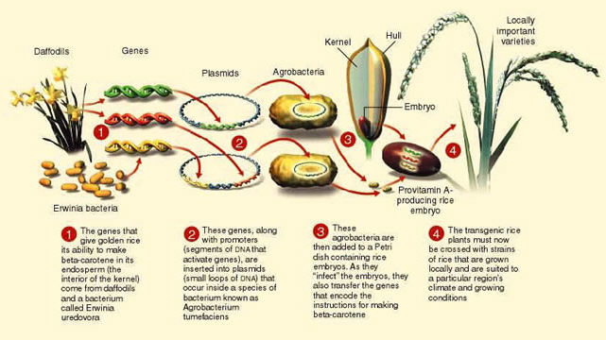
Examples of GMOs
Golden rice: engineered to contain pro-vitamin A. Rice is the staple food for very large numbers of people, but is low in essential vitamins. Golden rice provides vitamin A, required for vision. (Biozone p. 215) https://infograph.venngage.com/p/219454/recombinant-dna-and-golden-rice

Slide 5
Pest-resistant cotton: engineered to contain its own pesticide, reducing the need for broadscale spraying https://encrypted-tbn0.gstatic.com/images?q=tbn:ANd9GcSGyueAiXjN1VxMcSORZYBH8kFsb8IB19NBfVadH_fuNuCGUlUD9g

Slide 6
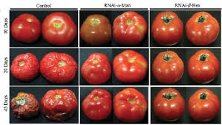
Tomatoes have been engineered to last longer by switching off the gene for ripening. This extends the shelf life of the tomato http://www.deccanherald.com/content/50265/gm-tomato-gives-45-day.html

Slide 7
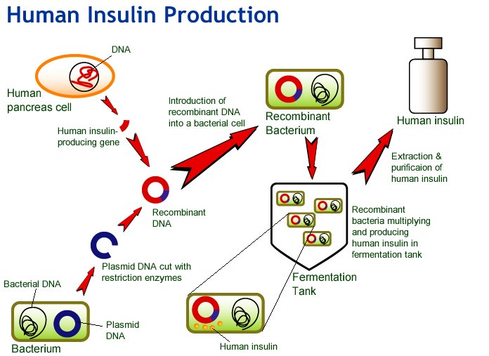
Recombinant yeasts or bacteria (seen below) produce human insulin for use by diabetics. Prior to this, insulin was harvested from pigs, causing allergic reactions in some people https://www.eduhk.hk/biotech/eng/classrm/explain/health3.jpg

Slide 8
Techniques
You need to understand how and why these are used:
Restriction enzymes
Ligation
Polymerase chain reaction (PCR)
Gel electrophoresis
DNA microarrays (aka DNA chips)

Slide 9
Restriction enzymes
The structure of DNA is the same regardless of the species it comes from.
Enzymes associated with DNA in one species will therefore work in all species.
Restriction enzymes work by cutting the sequence of DNA at a particular base sequence
Their natural role in a cell (usually bacterial) is to protect the cell from viral DNA, which is cut by the enzyme and thus made inactive

Slide 10
Restriction enzymes
This diagram shows the effect of one particular restriction enzyme. It cuts the DNA strand at a particular group of bases.
This enzyme has produced “sticky ends”, ie overhanging bases that will be used to join the fragment that is required to be inserted

Slide 11
Restriction enzymes
This diagram shows 3 different restriction enzymes and their effect. The top one produces “blunt ends” with no overlap, while the bottom 2 show sticky ends
It shows that each enzyme cuts the DNA in different places

Slide 12
Restriction enzymes
There are now around 900 different restriction enzymes, isolated from over 230 different strains of bacteria.
These provide researchers with a significant “tool box” with which to select different genes
The enzymes are named according to the bacterium from which they were isolated eg: EcoR1 comes from Esherischia coli.

Slide 13
Ligation
This is the process that joins the fragments produced by restriction enzymes, so inserting them into the new species.
It is catalysed by the enzyme DNA ligase
The sticky ends of the cut fragments pair up according to the standard rule (A-T; C-G)

Slide 14
Ligation
This diagram shows how a restriction enzyme is used to cut the circular DNA molecule (plasmid) found in bacteria (pink). The same enzyme is then used to cut the DNA that is required (blue). The sticky ends of each will then join up (with the help of another enzyme, ligase), inserting the required gene into the plasmid. This technique has been used to put the human insulin gene into bacteria, which then produce it in large quantities for use by diabetics

Slide 15
Polymerase Chain Reaction
This technique makes multiple copies of segments of DNA very rapidly
It uses the enzyme DNA polymerase
It targets STR (short tandem repeats) aka microsatellites. These are regions of non-coding DNA that are unique to an individual
It has many uses, including
Detecting infectious organisms,
Genetic screening of inherited disorders,
Evolutionary studies using tiny samples from fossils
Forensic studies

Slide 16
Steps in PCR
Target DNA is denatured by heating it to 90-96⁰C. This is called melting, and produces single strands of DNA
Primers are added after cooling the sample to 55-60⁰C. These are short, single strands of nucleotides and must be duplicates of the sequences either side of the piece of nucleic acid that we want to copy. These bind to their complementary bases along the single strands of DNA. This is annealing
Polymerase and nucleotides are added and the sample is heated to 72⁰C. A new copy of the nucleic acid is made from the starting sequences formed by the primers. This is extending.
At the end of this process, there are 2 strands, each with one old piece and one new piece of the required gene
The cycle then repeats as often as necessary
96⁰ 60⁰ 72⁰

Slide 17
PCR
The enzymes required in this process must be able to work at temperatures well above the normal range. Recall that high temperatures cause enzymes to denature!
The enzymes used in this process have been isolated from thermophilic bacteria, especially the hot springs species Thermus aquaticus. These enzymes are thermally stable, and do not denature at high temperatures
These enzymes are prefixed by Taq,
eg Taq polymerase, to indicate their source

Slide 18
Gel electrophoresis
This process separates fragments of DNA based on their size.
The sample is placed into a gel, and a current is passed through it. The DNA carries a negative charge, so it is attracted to the positive end.

Slide 19
Gel electrophoresis cont’d
Large pieces move the least distance, small pieces move the most distance
The different samples can then be compared, because the different lengths are stained with a dye, and will show up as a series of bands
The more bands in common, the closer the match

Slide 20
Gel electrophoresis https://schoolworkhelper.net/gel-electrophoresis-basics-steps/

Slide 21
Uses of Gel Electrophoresis
Forensics: comparing DNA in the victim and the suspects
Conservation biology: comparing the DNA of captive bred species in a breeding program to prevent inbreeding; identifying samples of meat to determine whether it is from an endangered species; measuring the genetic diversity of small populations
Sequencing DNA (ie finding out the order of the nucleotides)

Slide 22
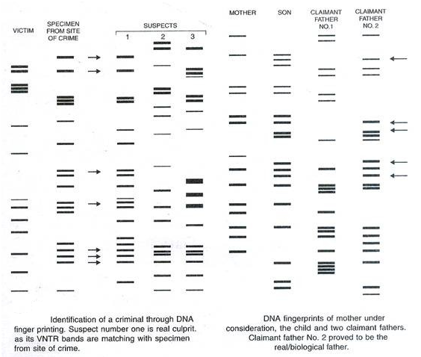
Examples of electrophoresis profiles

Slide 23
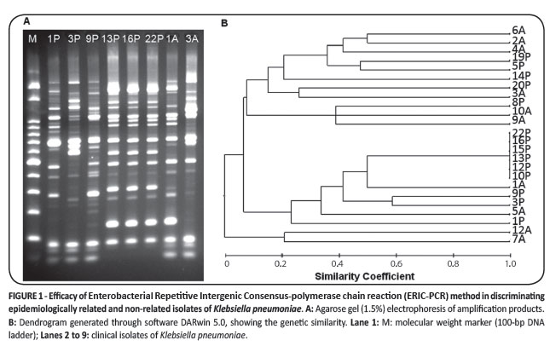
This shows how a gel can be used to find relatedness among different organisms. The more bands in common, the more closely related the organisms
http://www.scielo.br/scielo.php?script=sci_arttext&pid=S0037-86822012000500007

Slide 24
DNA sequencing
This is a specialised form of electrophoresis that results in a knowledge of the order of the nucleotide bases (A,T,C,G)
A very clear explanation can be found at
https://seqcore.brcf.med.umich.edu/sites/default/files/html/educ/dnapr/sequencing.html

Slide 25
DNA chips
AKA DNA microarrays
These are grids printed onto glass slides or a similar surface. At each point on the grid is a section of DNA that represents one gene. We can therefore use the grid to determine which genes are switched on, and which are not. This is useful when studying cancer cells, or antibiotic resistance in bacteria.
A clear explanation of how these chips are made and used can be found at
http://learn.genetics.utah.edu/content/labs/microarray/

Slide 26
DNA chip summary

Slide 27
Ethical considerations
Research into new uses for these technologies is expensive. Private companies that carry out the research need to make a profit to stay in business. This has led to situations where a company may try to take out a patent on a gene – how would you feel if one of your genes legally belonged to someone else?
Genetic screening can pinpoint genes that may cause health issues later in life. Who should have access to this information? If you apply for a job, can your potential employer access this information to see whether you’re a risk because you carry a gene that may affect your health? Can insurance companies refuse you health insurance, or charge you a huge premium, because of your genes?
GMOs are fairly recent inventions – do we know the long term effects on human health of consuming them?
Could we “create a monster”? For example, some crop species have been engineered to be herbicide resistant, so the farmer can spray for weeds and not harm the crop. Can these genes ‘escape’ into natural populations of plants, rendering them resistant to herbicides too?

Slide 28
Ethical considerations cont’d
Some people suggest we should not create transgenic organisms, because we are effectively playing God. Critics of this argument state that we have a duty to alleviate the suffering of people who may be helped by better food supplies and improved medical treatment. Where do we draw the line? Who decides?

Slide 29
Text and Biozone pages
Text: Chapter 5
Biozone pages 189 - 219

